Slide 1
Language unites people. Ability to communicate begins with knowledge of language.
The family club «English for all»

Slide 2
« The human brain starts working at the moment we are born, and never stops until you stand up to speak in public »

Slide 3
Team work
We make up dialogues.
At the lessons we talk about different important problems.
We watch films together and listen to cassettes.

Slide 4
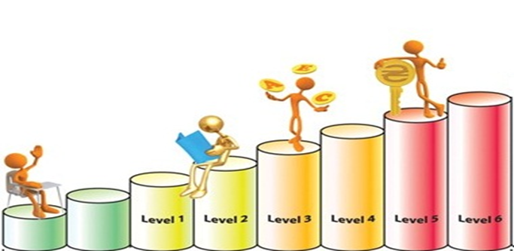
The education system
Our school uses the semester system of education. Each semester lasts for seven weeks and corresponds to one level. All levels are divided into beginner course and the main course.
Beginners course has two levels, classes
are held twice a week for 2 hours by
Russian-speaking teachers.
Main course consists of six levels, here
training is performed by American and
Russian teachers . People attend classes three times a week. Each class lasts for 2 hours. The first two levels are taught by Russian-speaking teachers (twice a week ) and once a week you have an opportunity to talk to the American teacher. At the third level you can have training with American teachers (twice a week ) and Russian-speaking teacher gives basic grammar , idioms and expressions (once a week) .

Slide 5
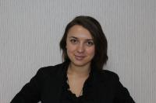
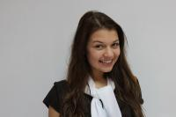
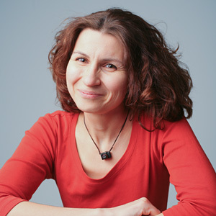
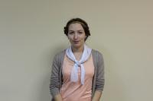
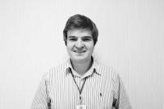
Our teachers
Irina Titova
Yaroslava Gonchar
Elena Stepanova
Yulia Borisova
Robert Brown
Mark Harris

Slide 6
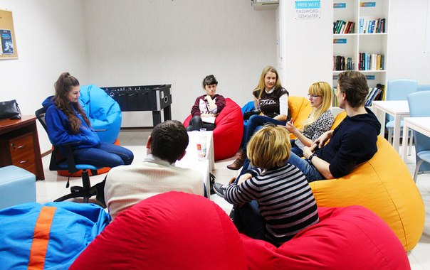
Additional services
English –Speaking Club
English-Speaking Club is an additional service that is offered to our listeners. You can attend it five days a week and improve your English. Highly qualified teachers from English-Speaking countries are always ready to help you.
English-café
It is an excellent place where you can chat with your friend with a cup of tea or coffee .

Slide 7
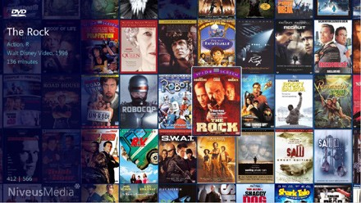
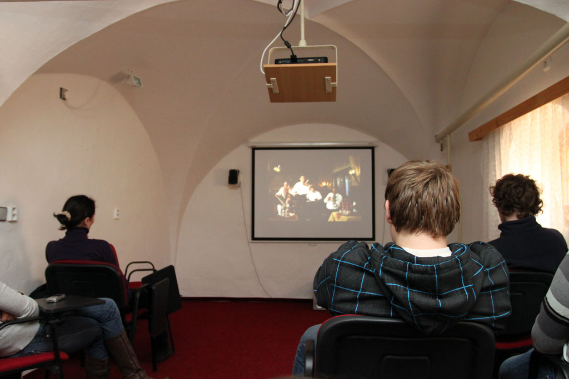
Additional services
Video Library
Rent films, also is a free service
Watching films in English is a very good way to improve your language. You improve spoken language, increase your vocabulary, get acquainted with the modern elements of spoken English. furthermore watching a movies in the original language is always a great fun!

Slide 8
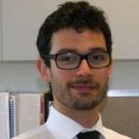
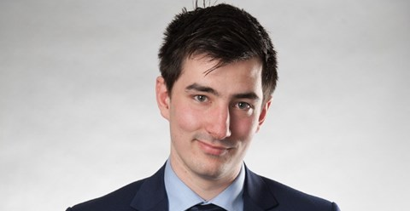
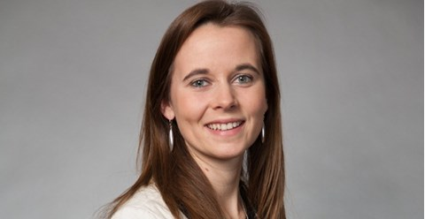
Our graduates
Dmitry Antonov: now lives in Canada and works at the Embassy of Ukraine in Canada
Aleksey Romanov: One of the most successful managers of Ukraine. Now he is working in the USA
Gromova Kseniya: She Lives and works in London

Slide 9
Payment for education
Payment for education you can made in any of the offices of our center before each semester.
The cost of the semester (7 weeks) UAH | Beginners course (1) | Beginners course (2) | Main course
 | 995 | 1095 | 1195
Conversation Club with American teachers (payment for one session per week during the semester - 7 sessions)UAH | when paying for basic lessons | without payment of main lessons
 | 120 | 250

Slide 10
Structure of investments
Office Equipments 25 520
Café Equipments 16 580
educational material 10 000
Rent (last month) 15 200
repair and minimal decor 20 000
total investment, UAH 87 300

Slide 11
Profit when 70% load
number of students 157
the average cost of the subscription 1 095
total revenue 171 915
Payment teachers, UAH 25 000
Payment Sales Manager, UAh 5 000
Payment administrators, UAH 7 000
Total payment 37 000
Rent, (200uah/sq.m) 15 200
Utility and light 1 520
Advertising costs 10 000
Consumables 1 600
Admin. costs (telephone, security. internet) 850
Total additional costs 29 170
profit 105 745

Slide 12
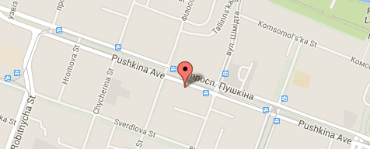
Our contacts
Pushkina ave.18
+3807772145
englishclub@yahoo.com

